Slide 1


PRESENTATION TITLE
CPSC-481 Artificial Intelligence
Final Project
Dr. Mira Kim
Computer Science Program

Slide 2
Cover Page
Pathfinding Algorithm In A Gridded Maze
Jason Meadows, Jarrod Burges, Jay Vang, Arturo Salazar

Slide 3
Problem Statement
How do different pathfinding algorithms interact and solve a user-created maze with start and end goals?

Slide 4
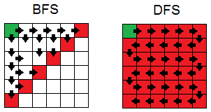
Approach
Python
Github
A*, Breadth-First, Depth-First Searches
PyGame package
Popular game engine package
PyGame-Gui package
Queue package

Slide 5
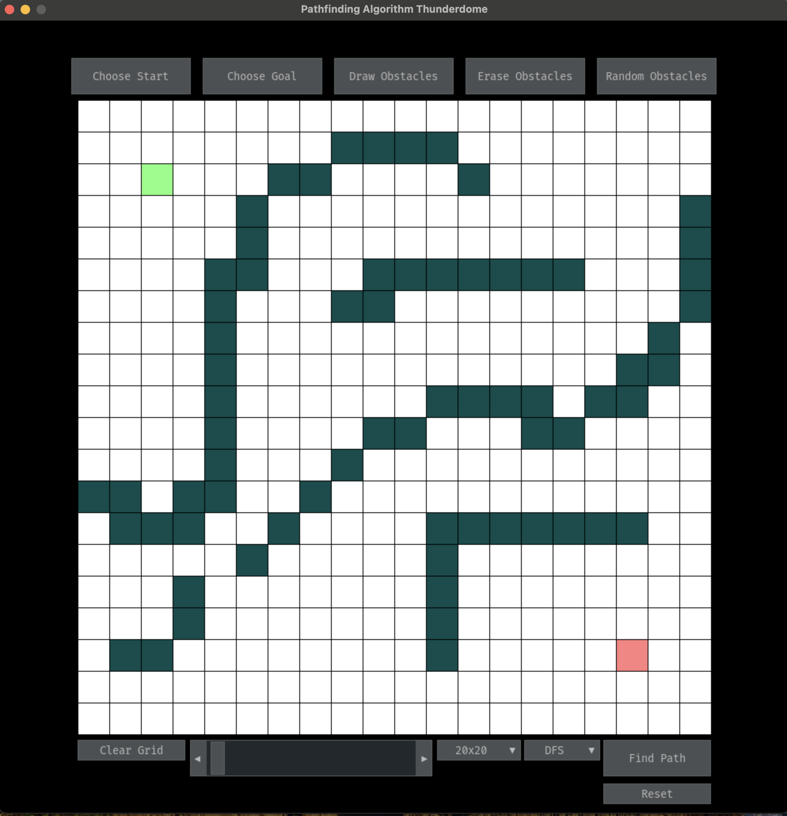
Description of Software
Variable Grid Sizes (20x20, 40x40, 80x80, 100x100)
Goal Start / Goal End
Obstacle Drawing
Choose a Searching Algorithm
Slider sets pathfinding speed
Clear Grid erases everything
Reset removes paths
Green = Start | Red = Goal
Purple = Obstacle

Slide 6
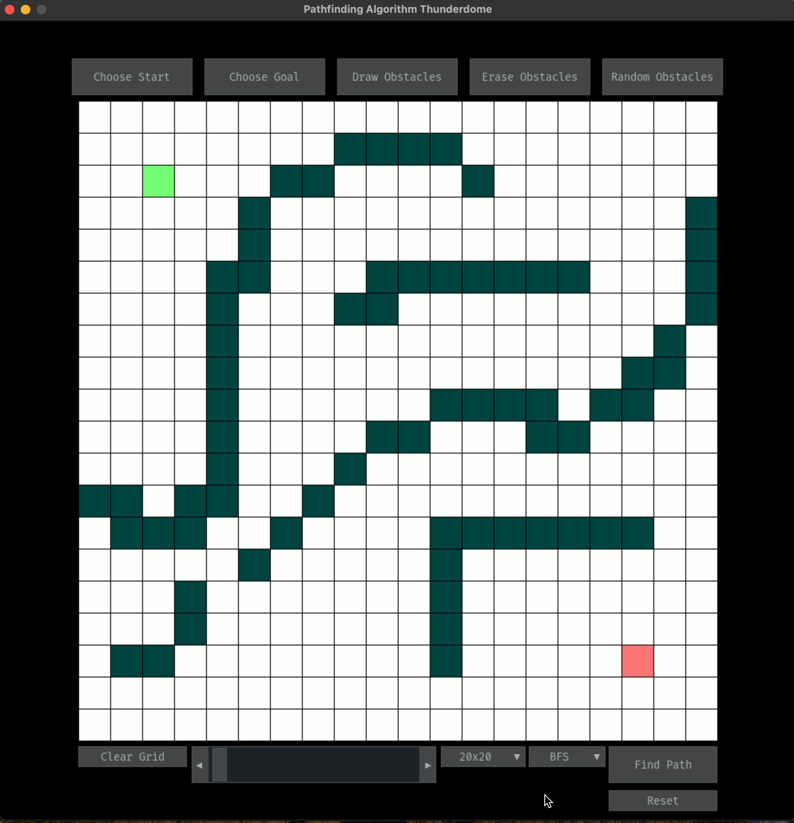
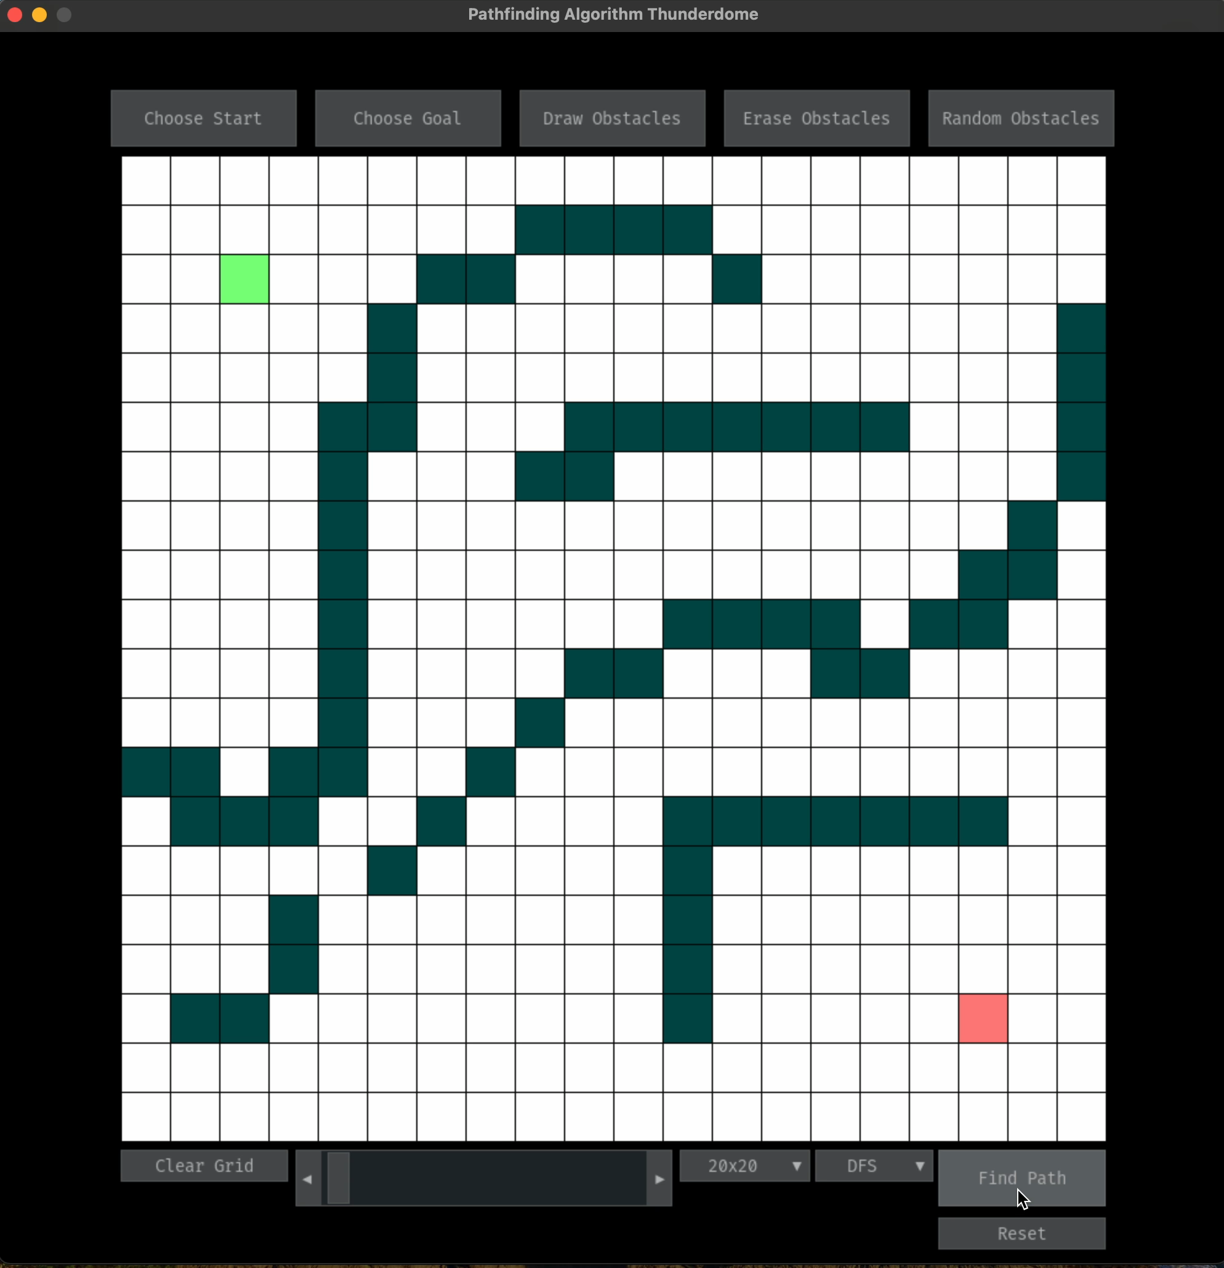
Evaluation

Slide 7
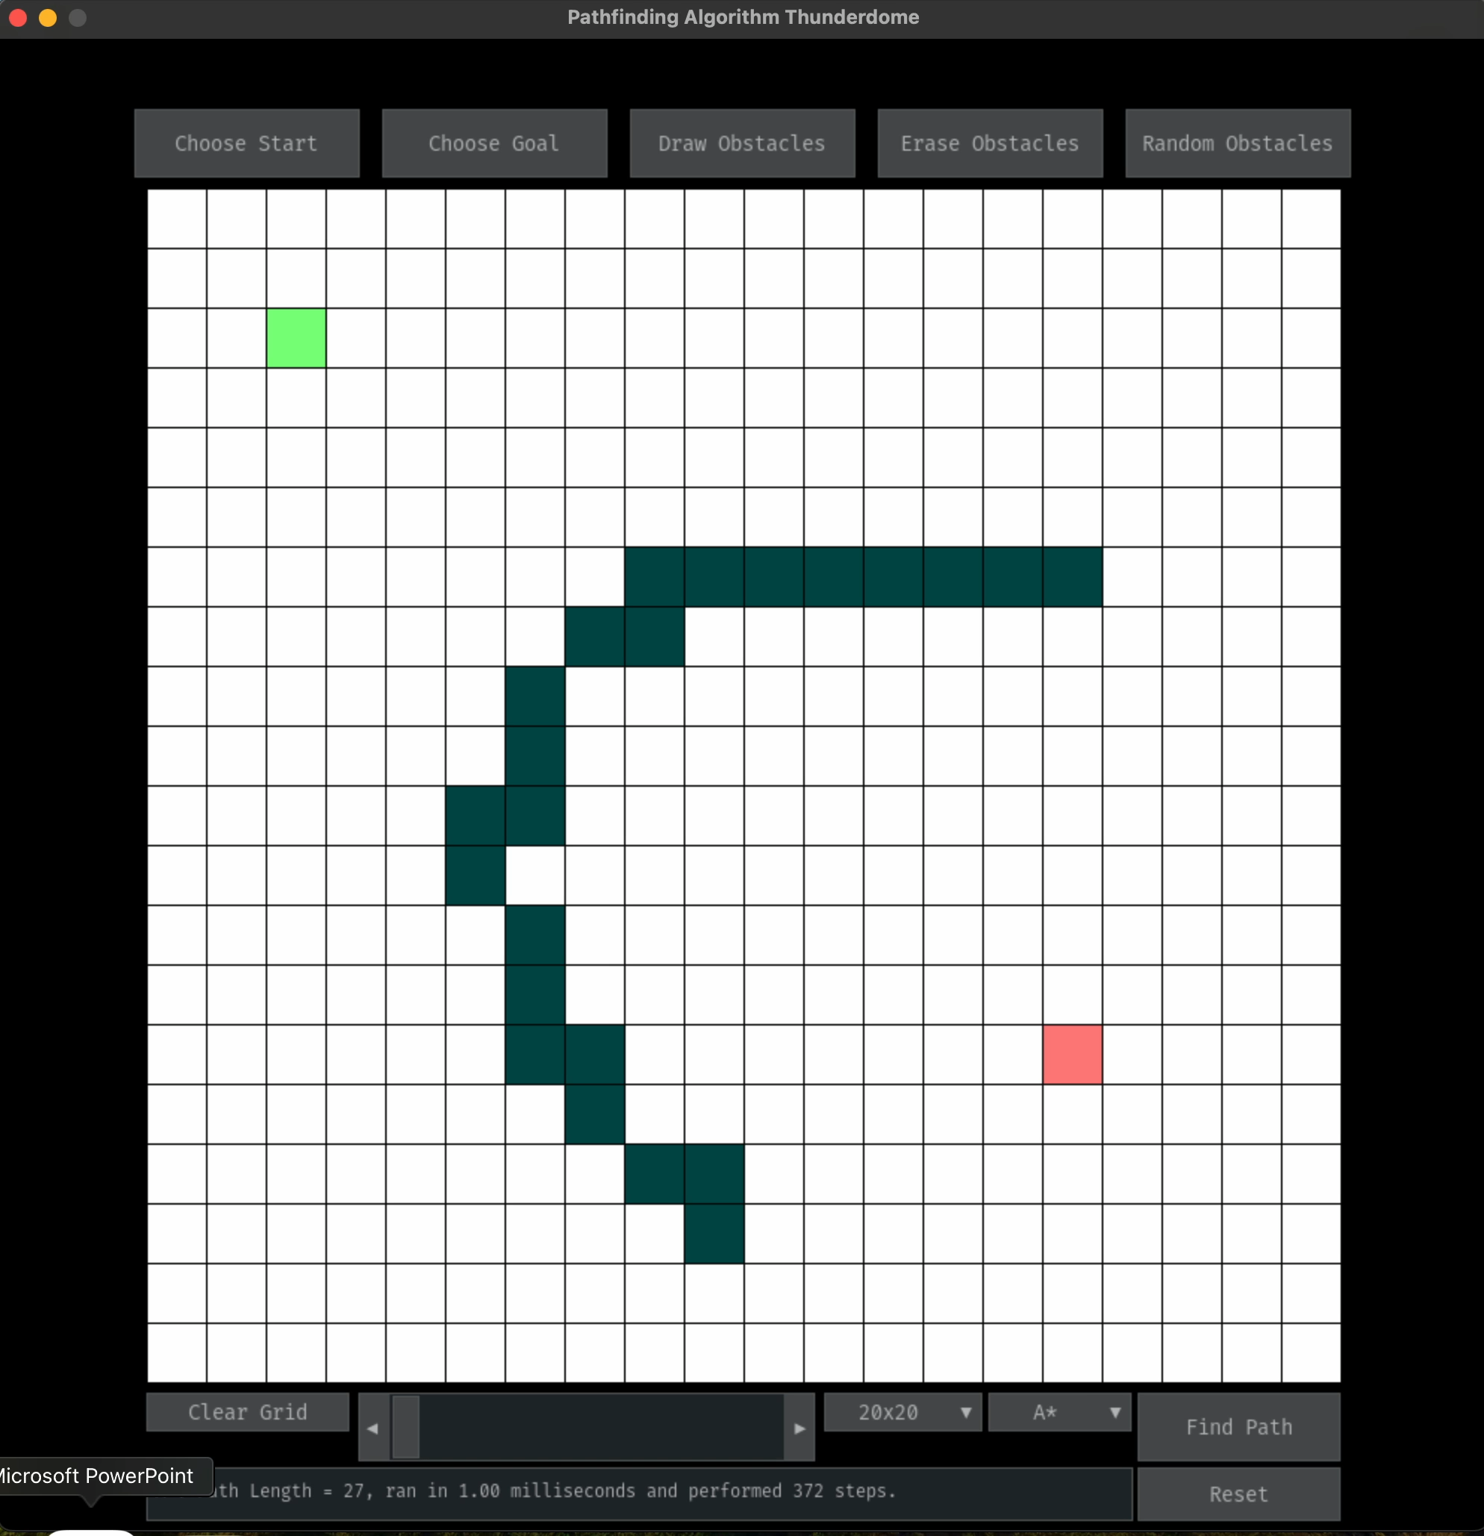
Evaluation

Slide 8
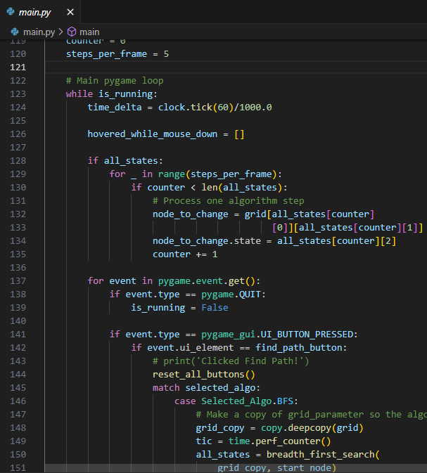
Code Layout: Main.py
PyGame loop
PyGame_Gui elements and UI

Slide 9
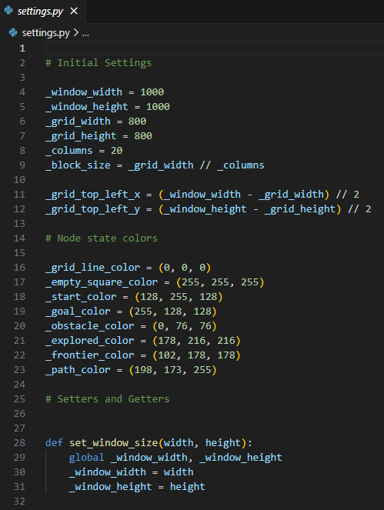
Code Layout: Settings.py
Basic configurations
Window size
Columns, block size, etc.
Colors
Setters and Getters
Get, set, update sizes and grids
Get and set colors

Slide 10
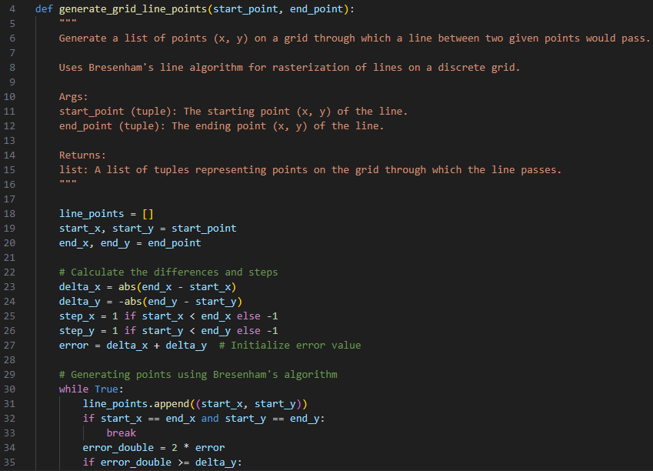
Code Layout: Utils.py
Utility functions
Bresenham’s line algorithm for rasterization of lines
Screen to grid function

Slide 11
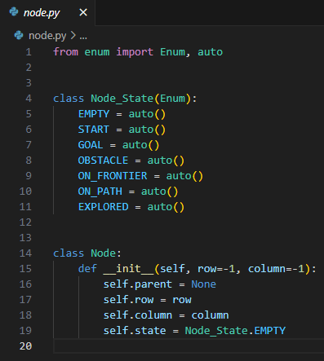
Code Layout: Node.py
Node class and Node_State class

Slide 12
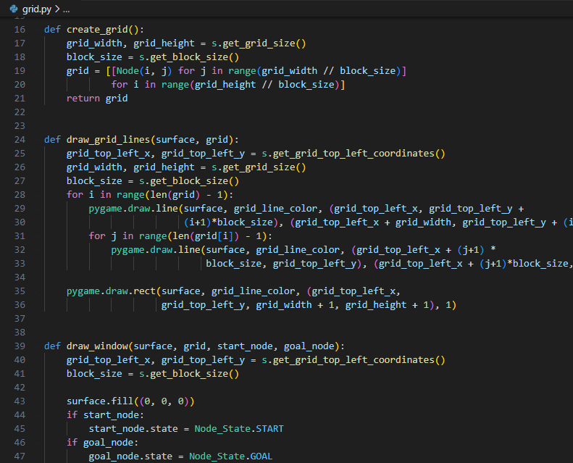
Code Layout: Grid.py
Grid functions
Creating and drawing grid
Uses Node Class
Draws lines and rectangles using PyGame’s .draw method
Drawing window
Filling background with color
Sets start and goal nodes
Count path lengths

Slide 13
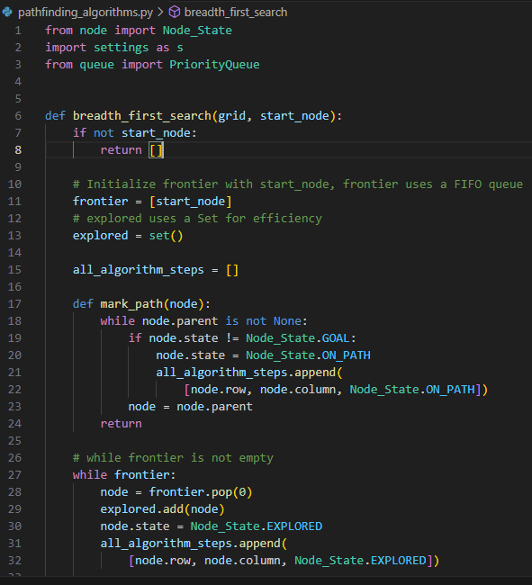
Code Layout: Pathfinding_algorithms.py
Astar, BFS, DFS, and Dijkstra’s functions

Slide 14
Questions?

